Slide 1
FRAUD CREDIT CARD DETECTION USING MACHINE LEARNING
TEAM MEMBERS
HEENA
MANSI
ARIF MOHAMMAND
Usha Devi

Slide 2
INTRODUCTION
Machine Learning, often abbreviated as ML, is a subset of artificial intelligence (AI) that focuses on the development of computer algorithms that improve automatically through experience and by the use of data.
Machine learning enables computers to learn from data and make decisions or predictions without being explicitly programmed to do so.

Slide 3
What is credit card fraud?
Credit card fraud is when someone uses your credit card or credit account to make a purchase you didn't authorize. This activity can happen in different ways: If you lose your credit card or have it stolen, it can be used to make purchases or other transactions, either in person or online.

Slide 4
OBJECTIVES
To preprocess and analyze credit card transaction data, addressing issues like missing values and imbalanced datasets.
To compare the performance of traditional ML algorithms (e.g., Logistic Regression, Decision Trees) with hybrid models for fraud detection.
To implement ensemble methods (e.g., Random Forest, Gradient Boosting) and hybrid models combining supervised and unsupervised learning.
To evaluate model performance using metrics like precision, recall, F1-score, and AUC-ROC.

Slide 5
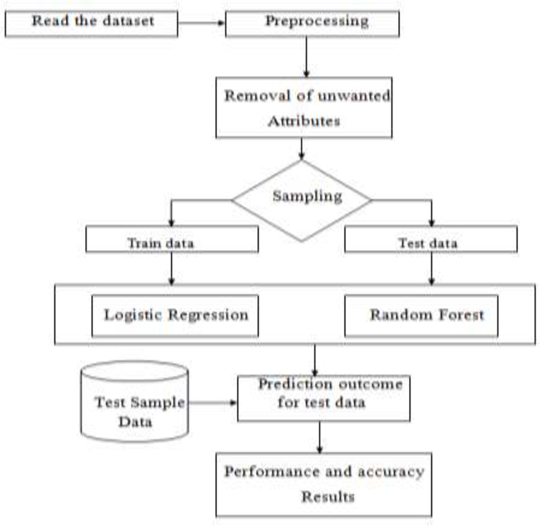
Methodology Workflow diagram

Slide 6
Dataset
Name of Dataset :creditcard.csv
collected from: https://www.kaggle.com
No of customers(records): 284807
No of features:31
No of Target var(dependent) :Class
feature(Int type) :1
feature(Float type) : 29

Slide 7
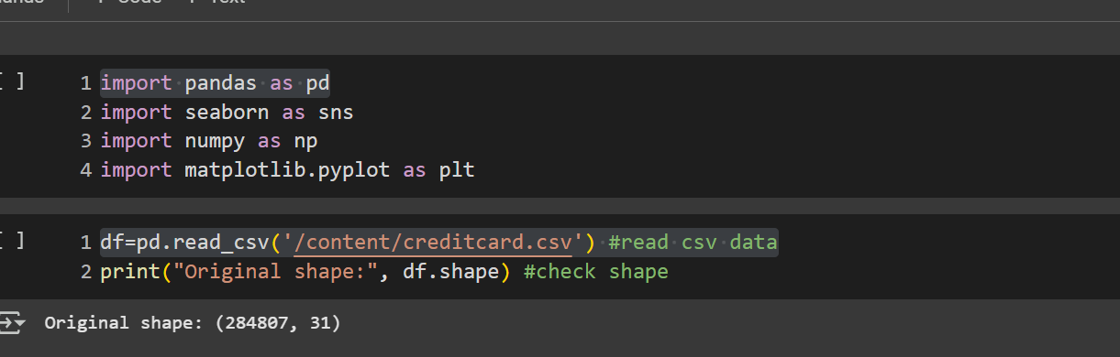
Implementation code description
import pandas as pd( import library)
df=pd.read_csv('/content/creditcard.csv’) (read csv data)

Slide 8
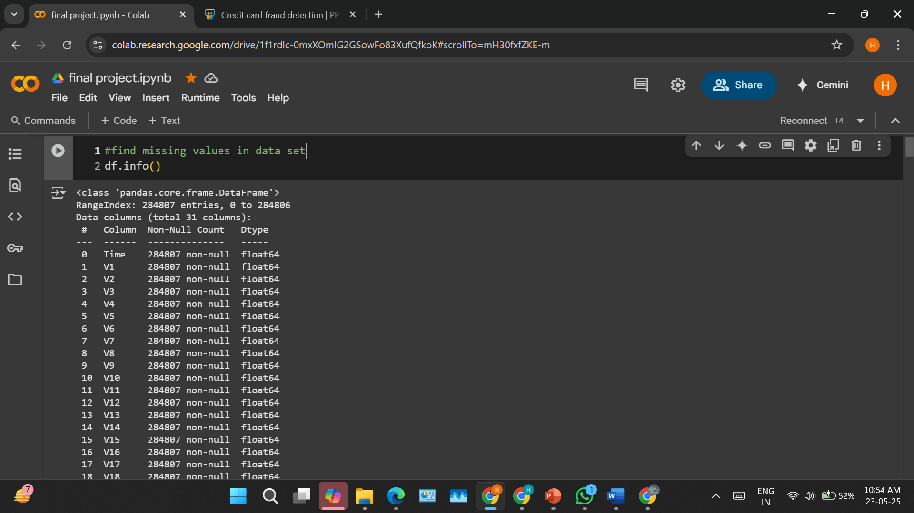
Pre-processing

Slide 9
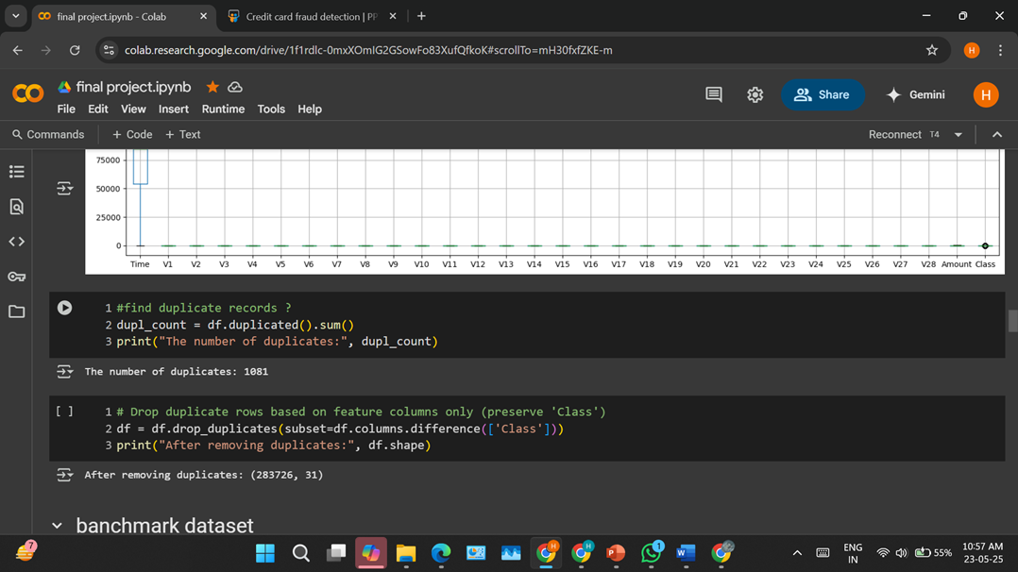
Duplicates values
1081 duplicate values

Slide 10
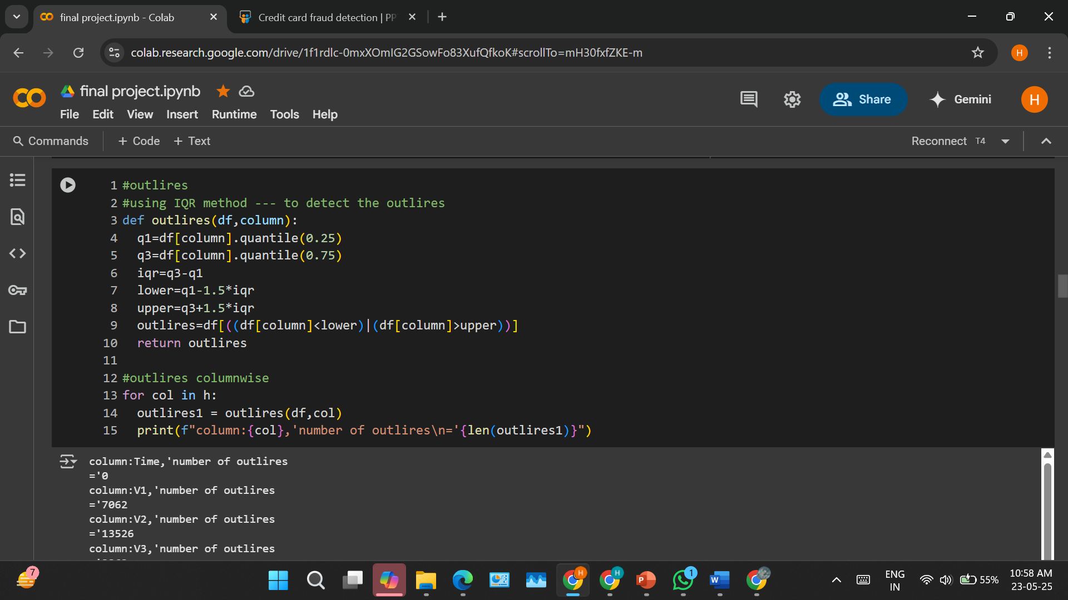
Outliers

Slide 11
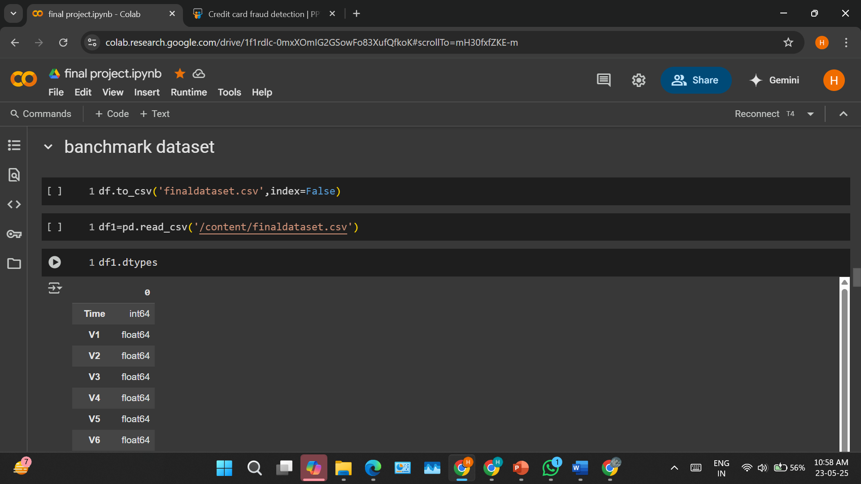
Benchmark data

Slide 12
module
Frame the problem
Collect the raw data
Download data from Kaggle
2 import the libraries
Pandas, NumPy, sklearn etc.
4. Process the data for analysis.
Perform the logistic regression on data
Explore the data.
5. Perform in-depth analysis.
6 Communicate result of the analysis

Slide 13
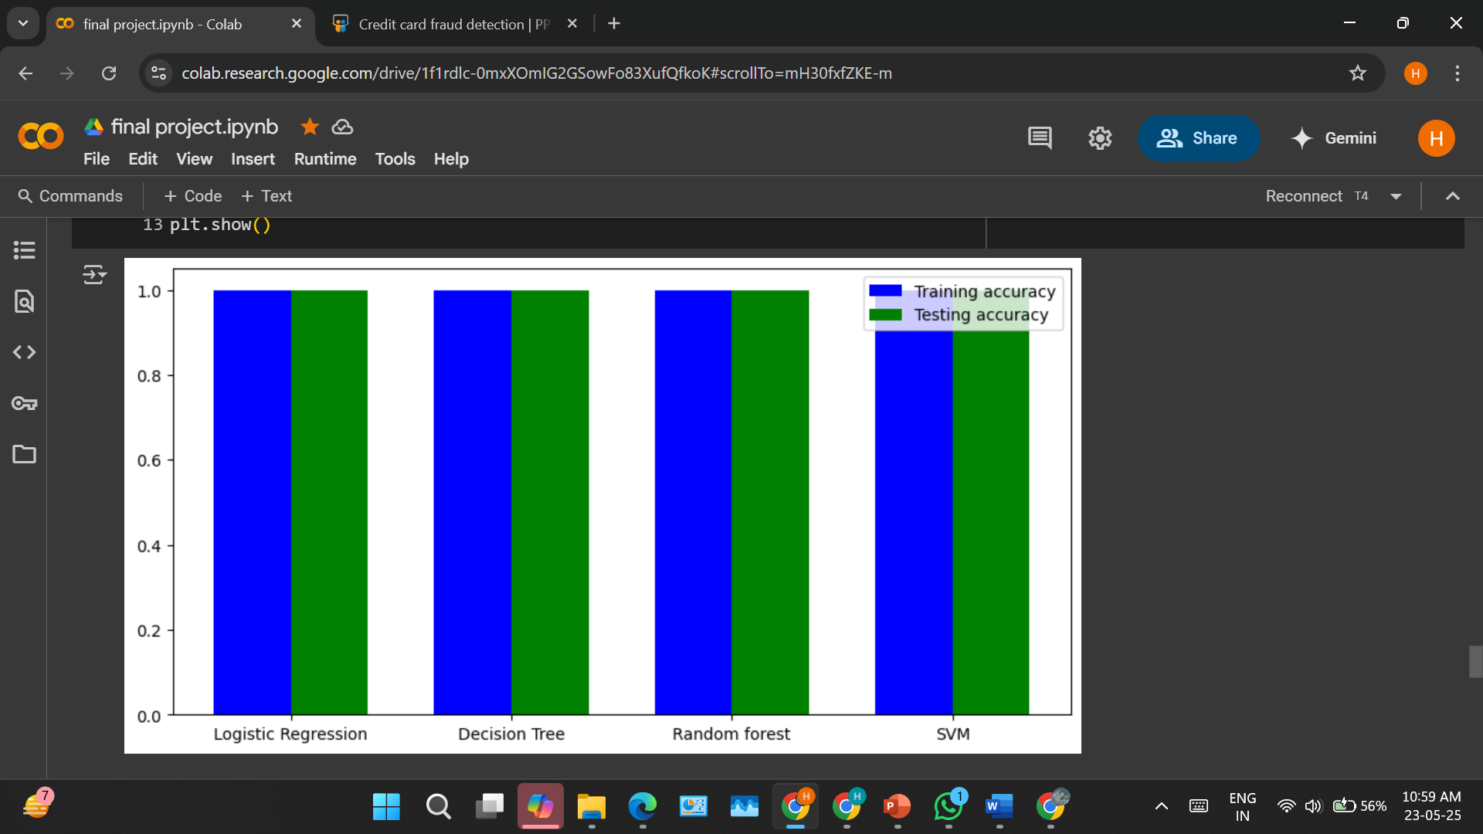
Algorithms comparison

Slide 14
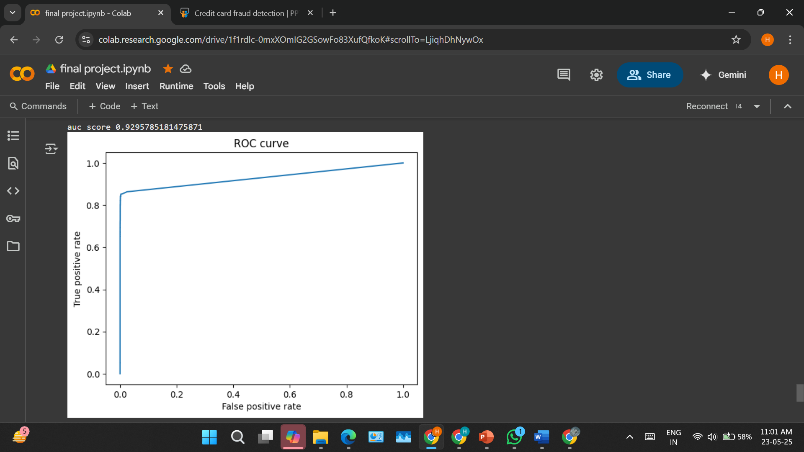
Roc curve

Slide 15
Thanks you

